Slide 1

Topic: Ocean Acidification Subject: Environmental Studies Department: Computer Engineering(07) Guided By: Dr. Hitesh Desai Dr. Ashish Desai Prepared By: Amul Luniya Enrollment No.: 160420107003
SARVAJANIK EDUCATION SOCIETY
SARVAJANIK COLLEGE OF ENGINEERING & TECHNOLOGY

Slide 2
CONTENTS
Introduction
Causes
Conditions
Commercially important organisms
Graphical representation of oceanic acidification
Effect on the marine life

Slide 3
INTRODUCTION
Ocean acidification is the ongoing decrease in the pH of the Earth's oceans, caused by the uptake of carbon dioxide (CO₂) from the atmosphere. Seawater is slightly basic (meaning pH > 7), and the process in question is a shift towards pH-neutral conditions rather than a transition to acidic conditions (pH < 7).

Slide 4
CAUSES
26 % increase in acidity due to CO₂ emissions
Many organisms show adverse effects (corals, molluscs)
Some thrive (e.g. seagrasses)
Ecosystems will change in the future
There will be socio-economic impacts and need for adaptation
Reducing CO₂ emissions will reduce impacts

Slide 5
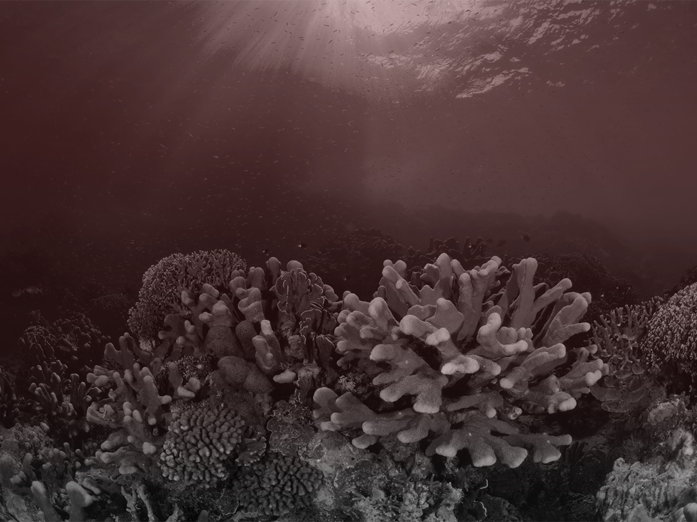
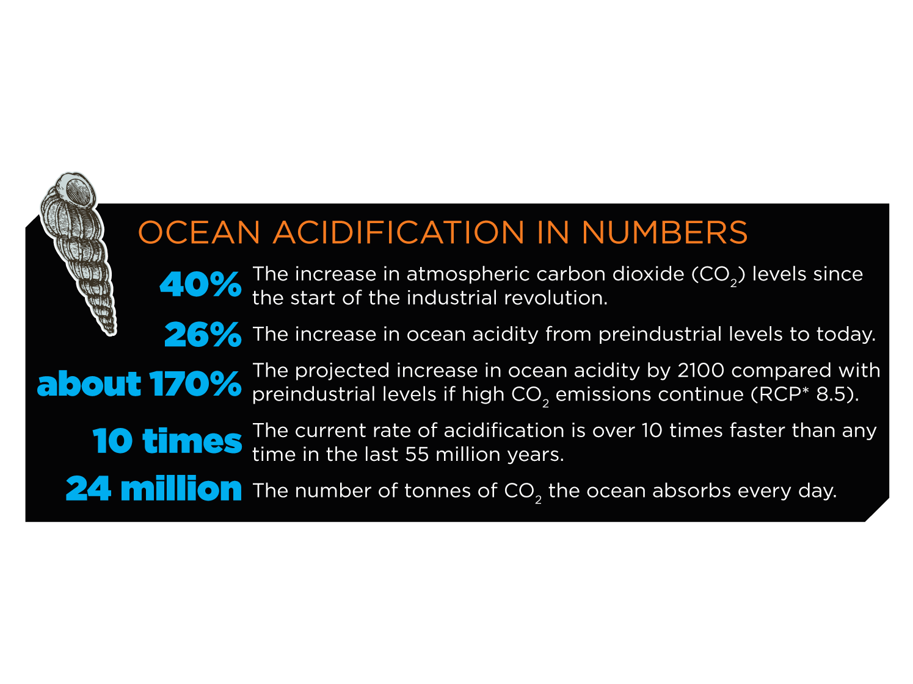

Slide 6
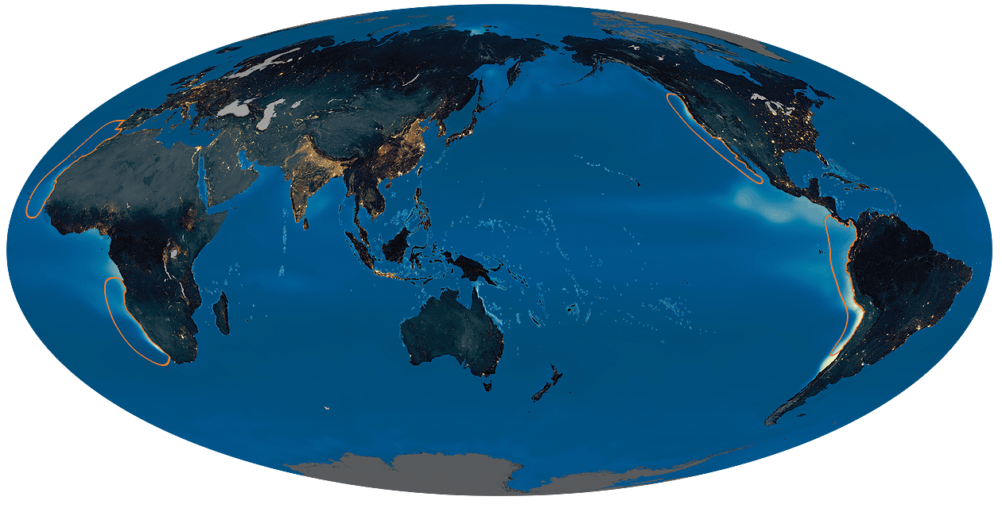
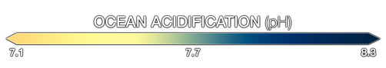
pH in 1850s

Slide 7
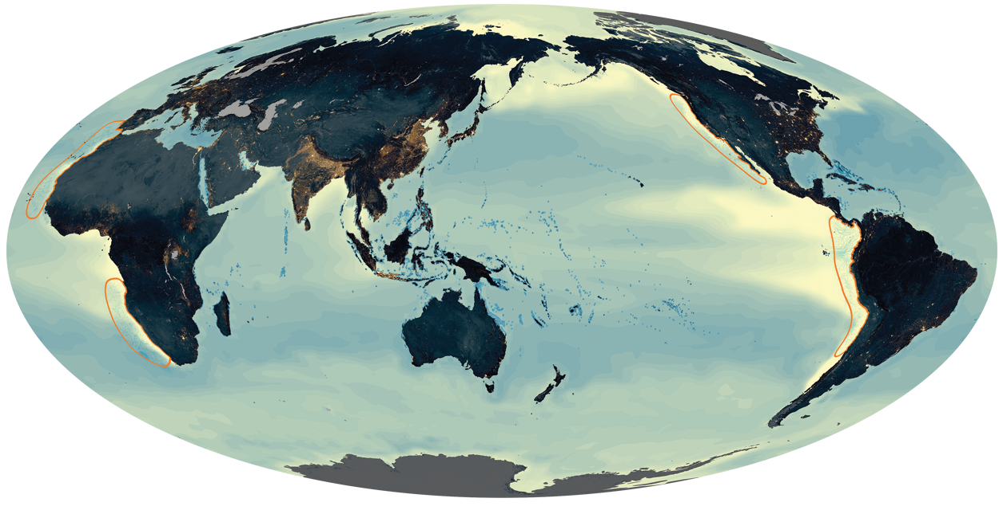
pH in 2100

Slide 8
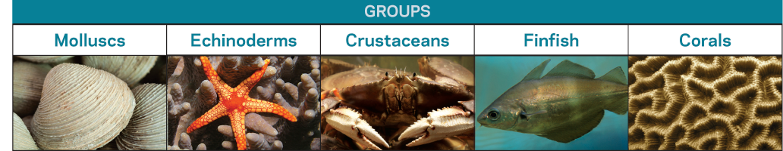
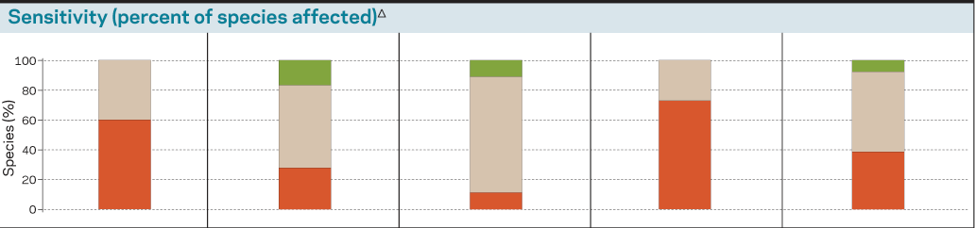
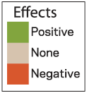
Commercially important organisms

Slide 9
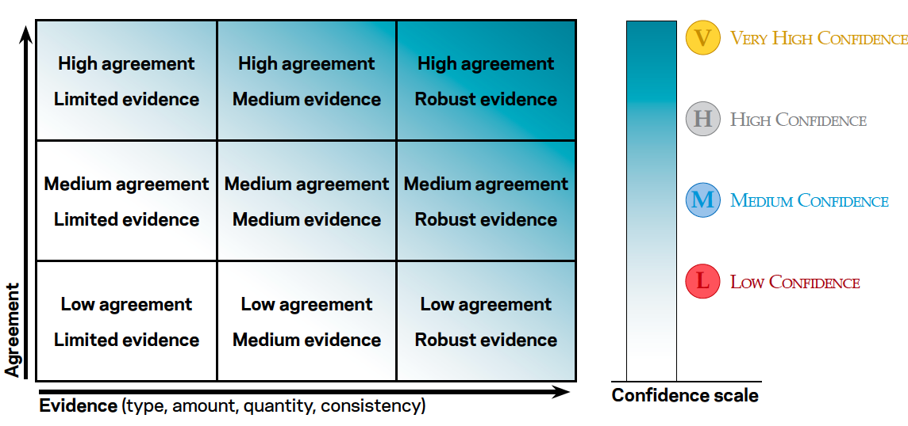
Confidence levels (IPCC)

Slide 10
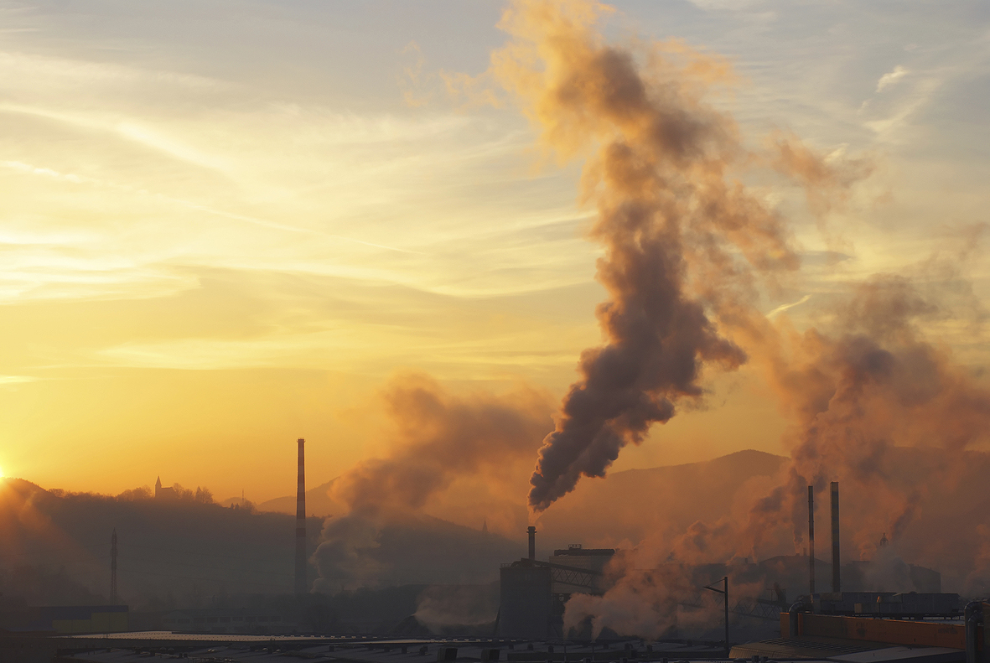
Ocean acidification is caused by CO2 emissions from human activity to the human atmosphere that end up in the ocean.
The capacity of the ocean to act as a carbon sink decreases as it acidifies.
The legacy of historical fossil fuel emissions on ocean acidification will be felt for centuries.

Slide 11
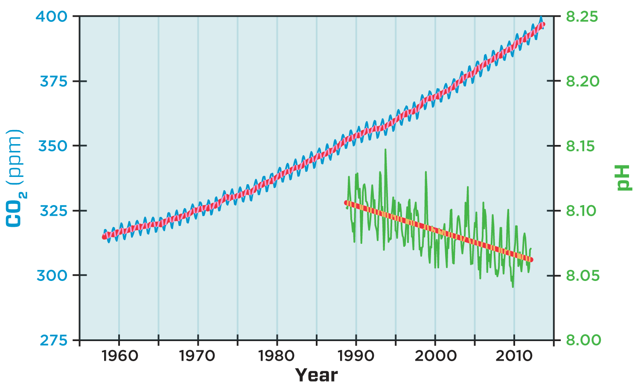
Atmospheric CO₂ and ocean pH
Anthropogenic acidification is currently in progress and is measurable.

Slide 12
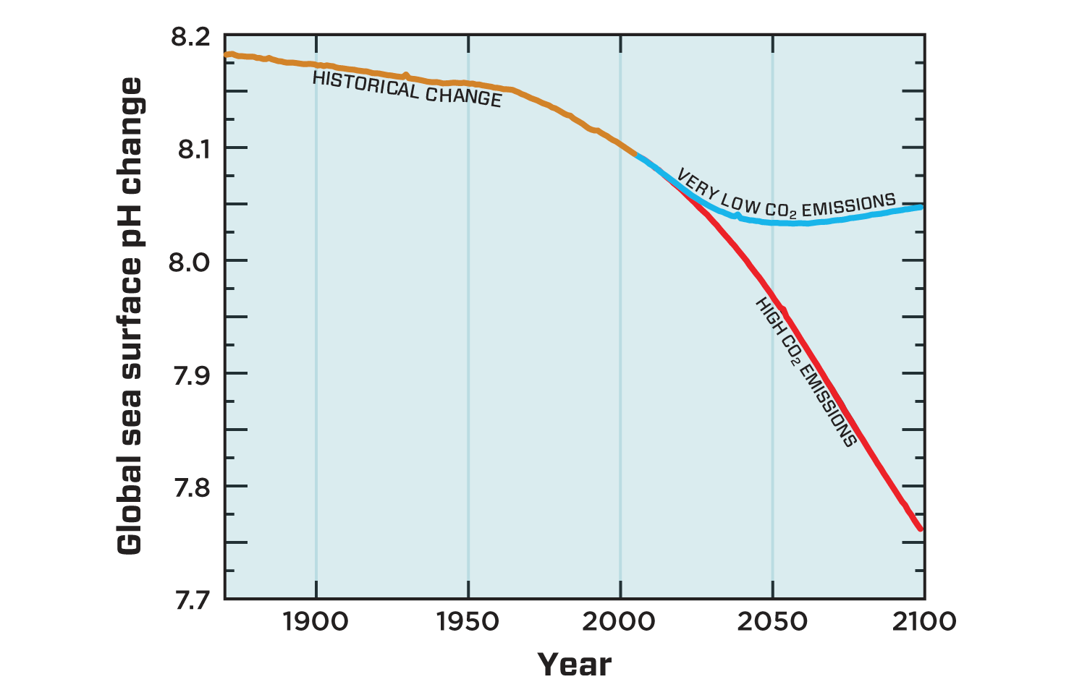
Ocean surface pH projections to 2100
Reducing CO2 emissions will slow the progress of ocean acidification.
Global
temperature increase likely
by 2100:
0.9°–2.3°C
3.2°–5.4°C

Slide 13
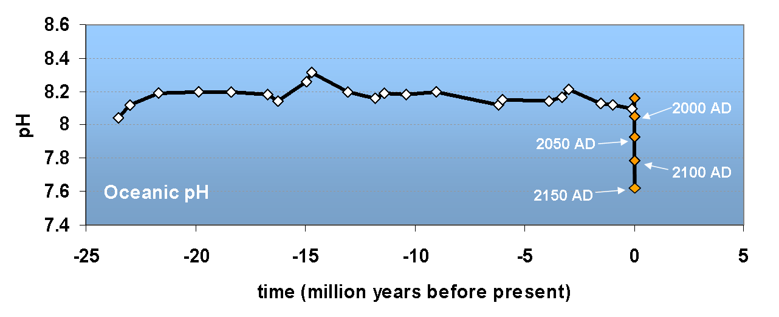
Rapid ocean acidification
The ocean is acidifying more rapidly than it has in millions of years.

Slide 14
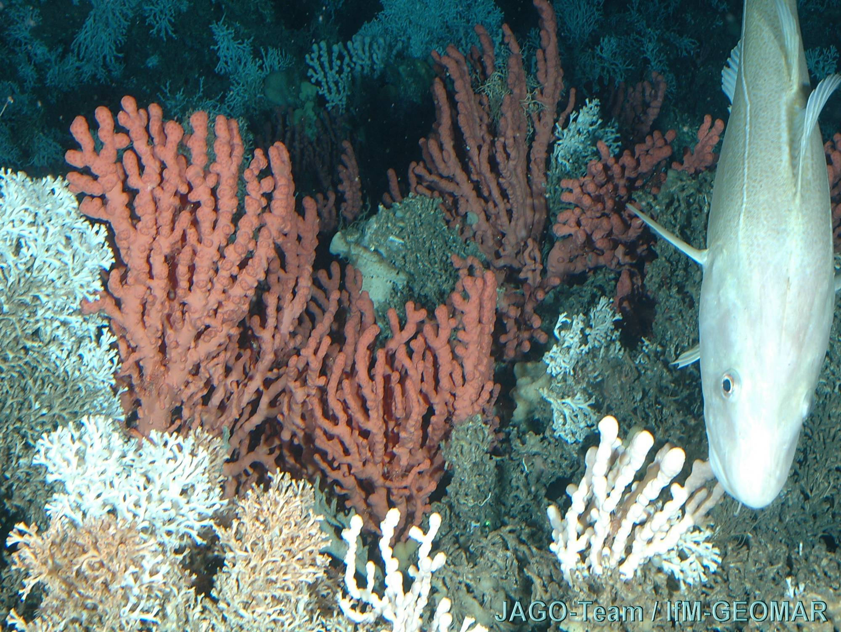
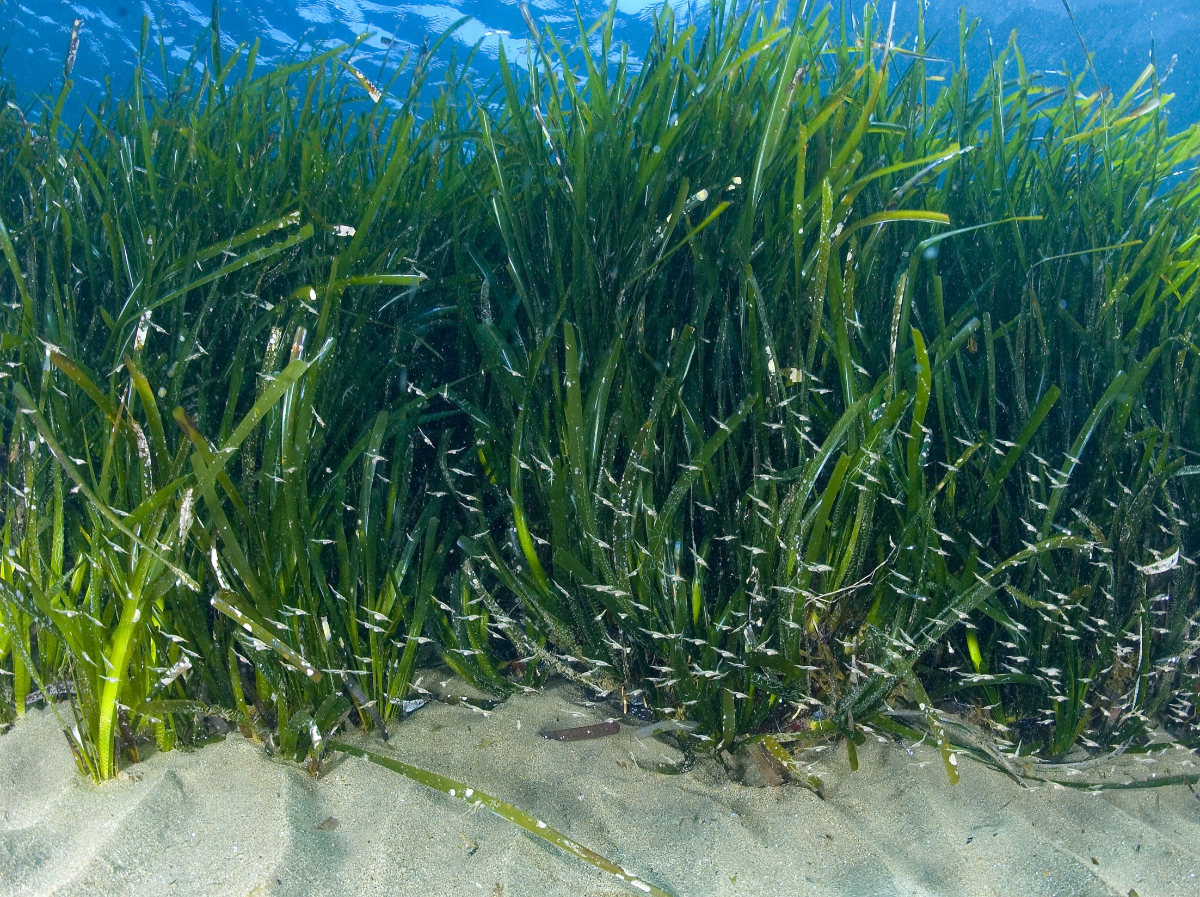
Winners and losers
Cold-water coral communities are at risk and may become unsustainable.
Some seagrass and phytoplankton species may benefit from ocean acidification.

Slide 15
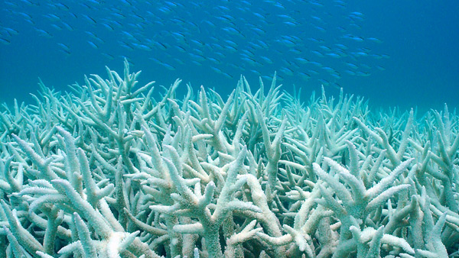
Hot, sour and breathless
Multiple stressors compound the effects of ocean acidification.
The combination of ocean acidification and increased temperatures negatively affects many organisms.

Slide 16
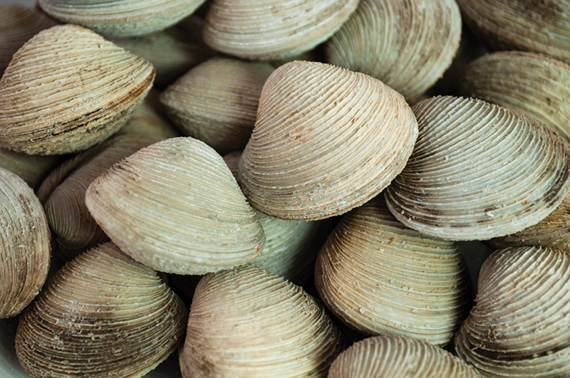
Molluscs
Molluscs (such as mussels, oysters and pteropods) are one of the groups most sensitive to ocean acidification.

Slide 17
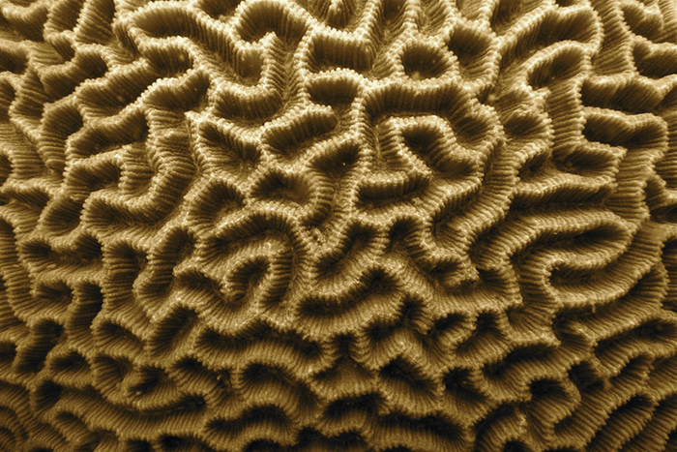
Coral Reefs
If CO2 emissions continue on the current trajectory, coral reef erosion is likely to outpace reef building sometime this century.

Slide 18
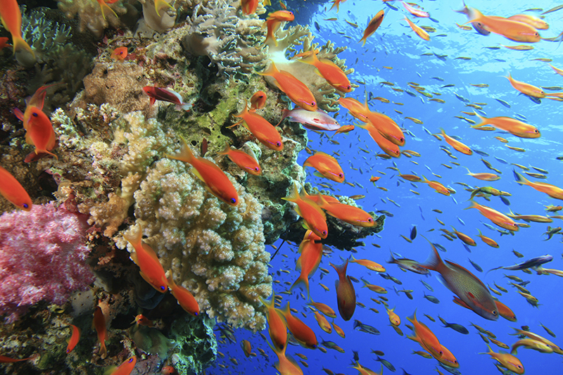
Changes in marine ecosystems
The varied responses of species to ocean acidification and other stressors are likely to lead to changes in marine ecosystems, but the extent of the impact is difficult to predict.

Slide 19
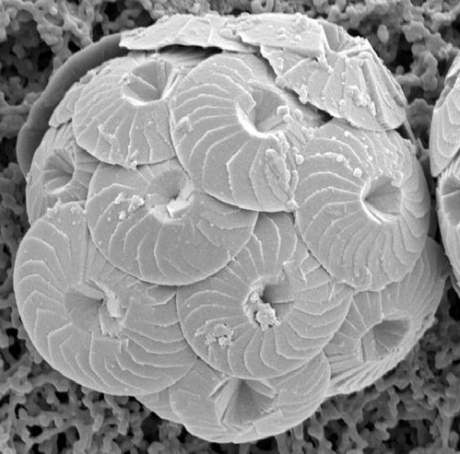
Calcifying organisms
Anthropogenic ocean acidification will adversely affect many calcifying organisms.

Slide 20
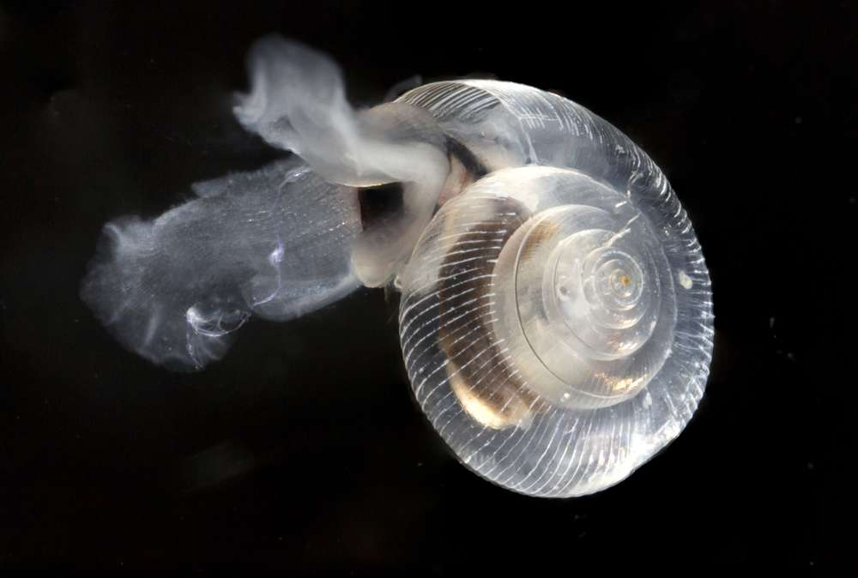
Marine snails
Pteropod (marine snail) shells are already dissolving.

Slide 21
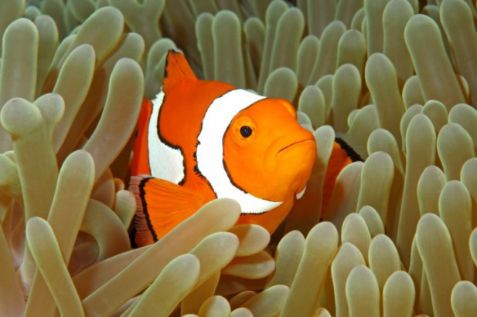
Fish behaviour
Ocean acidification may have some direct effects on fish physiology, behaviour and fitness.

Slide 22
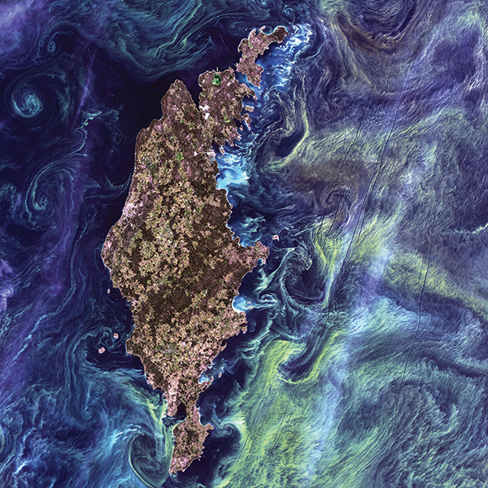
Nitrogen fixation stimulated
Nitrogen fixation in some cyanobacteria may be stimulated by ocean acidification.

Slide 23
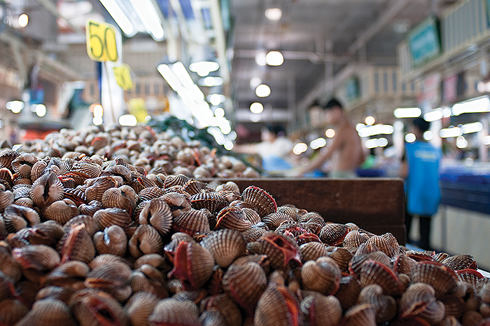
Economic losses
Declines in shellfisheries will lead to economic losses, but the extent of the losses is uncertain.

Slide 24
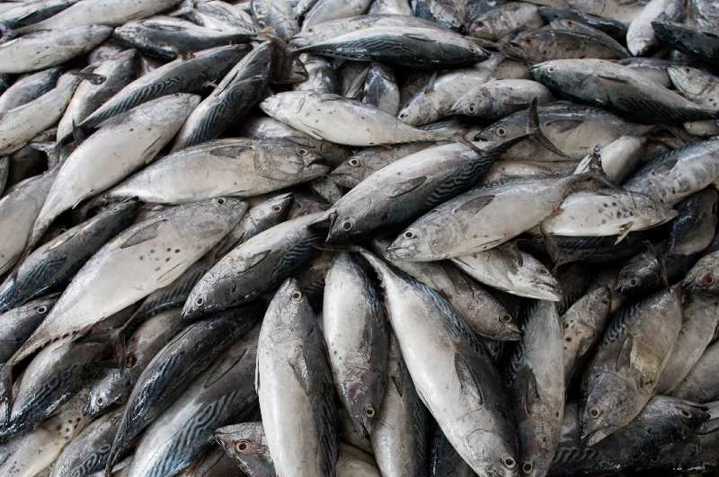
Fisheries
Impacts of ocean acidification on ecosystems may affect top predators and fisheries.

Slide 25
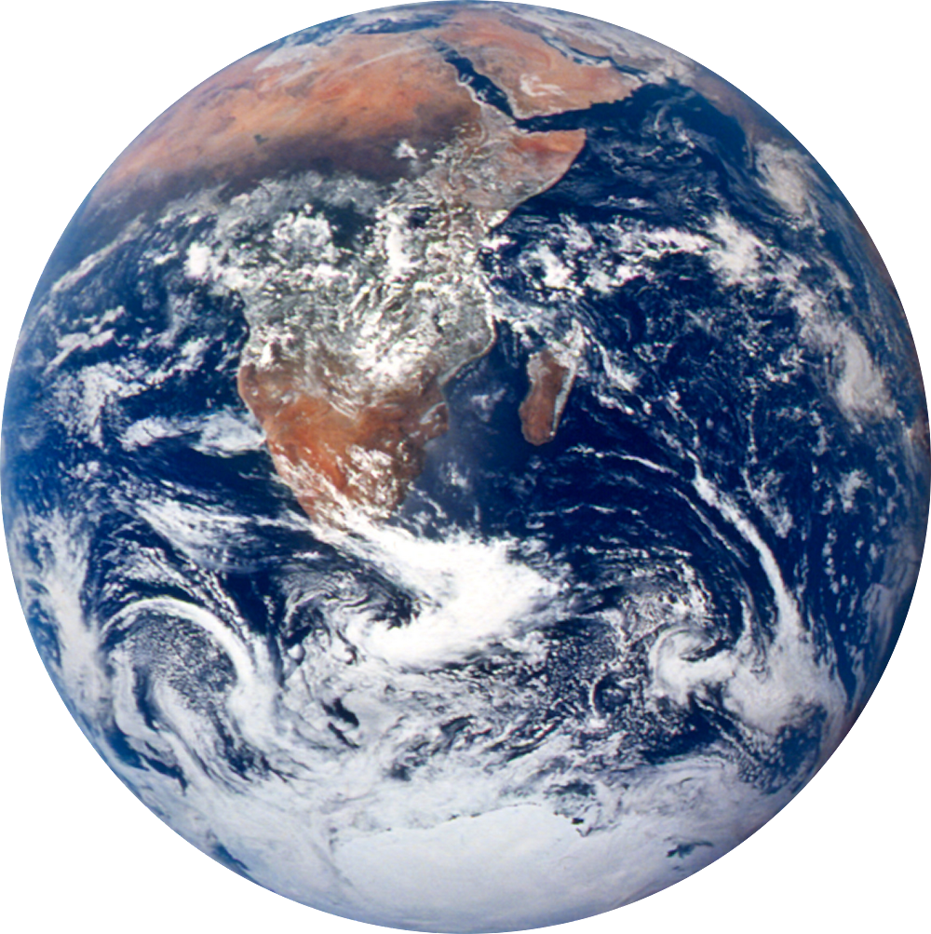
Biogeochemical cycles
Ocean acidification will alter biogeochemical cycles at a global scale.

